Slide 1
STANDARD DEVIATION AND ITS MEASURES
BY
Sanat Arun Kumar Mishra (A041)
Harshit Deshmukh (A040)
Siddh Anil Shah (A012)
Taksh Mathur (A011)
Shivan Bhura (A001)

Slide 2
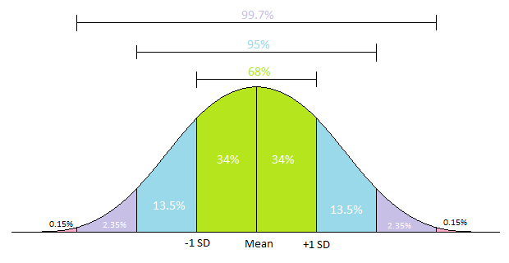
Standard Deviation
A statistic that measure the dispersion of a dataset relative to its mean and is calculated as the square root of the variance.
Standard deviation is a statistical measurement in finance that, when applied to the annual rate of return of an investment, sheds light on that investment's historical volatility.
It is used to test the reliability of mean. Mean of a distribution with least standard deviation is said to be more reliable.

Slide 3
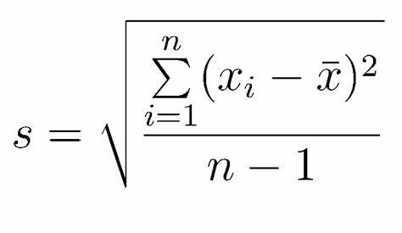
Standard Deviation Formula
where:
xi​=Value of the ith point in the data set
x=The mean value of the data set
n=The number of data points in the data set​

Slide 4
Uses Of Standard Deviation
Finance and Business – financial analysts and business-owners use for risk-management and decision-making.
Quality Control - Quality control in production and manufacturing is vital to keep up standards.
Polling - The margin of error in these polls are calculated using standard deviation.

Slide 5
Apple Stock Volatility [Standard Deviation]
Here is a simplistic analysis report of standard deviation of Apple Inc (AAPL) stock price. In addition, this report compares the volatility of AAPL stock with similar stocks. Towards the end, you will see the highest and least volatile months in history.
In simple terms, higher the volatility for a time period, greater will be the price variations during that period. Generally high volatile stocks are less predictable and vice versa.

Slide 6
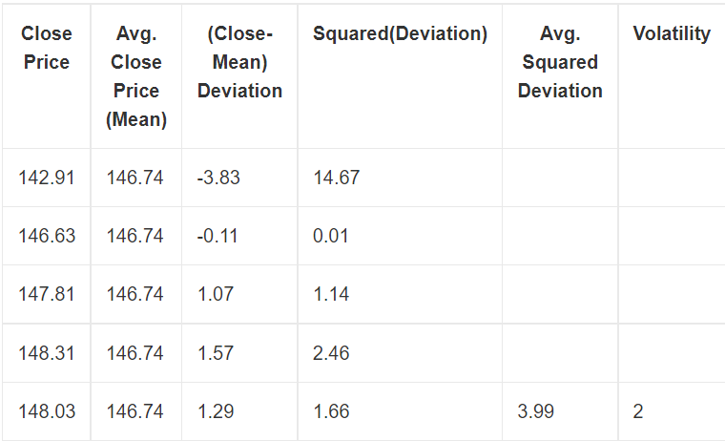
Steps To Calculate Volatility.
The steps that go into the calculation are the following. You can use a spreadsheet program or even a pen and paper for computation.
Once you have decided the timeframe, list down the close prices (in a column/vertical format).
Calculate the average of the listed prices. We call it the mean.
Subtract the mean from the close prices.
Find the squares of the values obtained on the previous step.
Find average of all squared values obtained on the previous step.
The square root of the value of step 5 is the volatility.

Slide 7
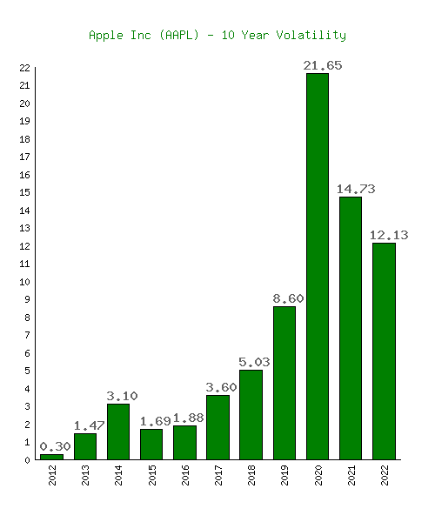
Apple Stock Volatility [Standard Deviation]
Here is a table followed by a graph showing 10-year historical volatility measures for Apple Inc (AAPL) stock.
As you can see, 2020 (21.65) was the highest volatile year for Apple Inc (AAPL) while 2012 (0.30) was the lowest one.

Slide 8
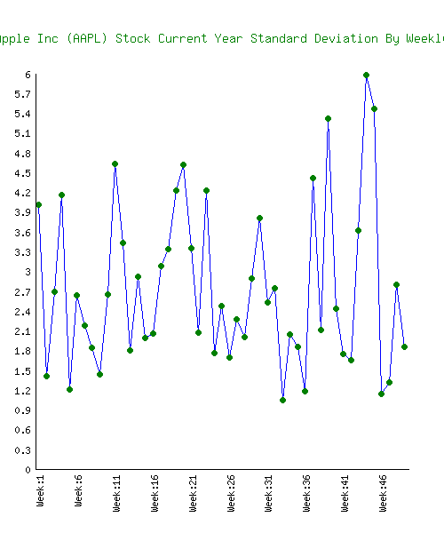
3 Apple Inc (AAPL) Stock Weekly Standard Deviation
Weekly volatility graph helps you visualize the weekly swings (either positive/negative) you can expect from a stock
This 52 week volatility graph will help you visualize the price swings during the current year.

Slide 9
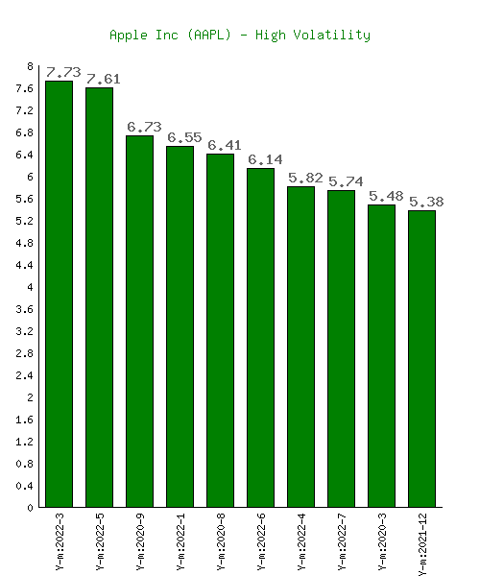
10 Highest Volatile Months For Apple Inc (AAPL)
This section displays the 10 highest volatile months of AAPL in 10 years. If you think the volatility of the current month is high, you can check that value against the previous 10 highest values.

Slide 10
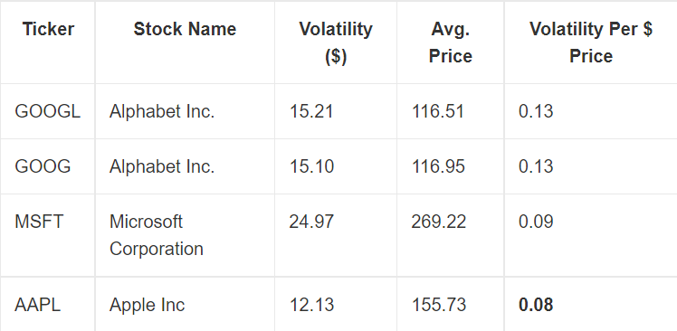
AAPL Stock Annual Volatility Of 2022 Against 3 Similar Stocks
This section compares the volatility per $ share price of Apple Inc (AAPL) against 3 similar stocks. The table is sorted in the order of highest to lowest volatile shares.

Slide 11
Conclusion
Standard deviation, in finance, is often used as a measure of a relative riskiness of an asset.
A volatile stock has a high standard deviation, while the deviation of a stable blue-chip stock is usually rather low.
As a downside, the standard deviation calculates all uncertainty as risk, even when it’s in the investor's favor, such as above-average returns.
Investors shouldn't base decisions solely based on volatility for a reason. The reason is the metric doesn't account for a bullish or bearish run. For example, a rapidly growing as well as a free-falling stock both can be highly volatile.
Before concluding, here is a general advice. If you are not confident of controlling emotions during high price fluctuations, you should stay away from high volatile stocks.

Slide 12
THANK YOU

